Slide 1

Bandit Problems Chris Amato Northeastern University with some slides from Rob Platt, Lawson Wong and UAlberta

Slide 2
Announcements
Assignment 0 (Intro) due next Wednesday 9/14
Assignment 1 (Bandits) is out very soon
Due 9/21
Self assessment
Piazza
Read chapter (1 and) 2

Slide 3
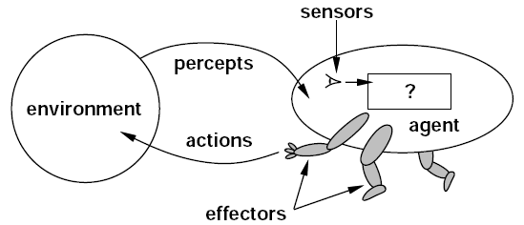
Reinforcement Learning
Need to make a sequence of decisions (a policy mapping, e.g., states to actions)
Future states depend on choices at earlier states
Optimizing expected sum of rewards over time
Learn over time by trial-and-error (like living things)
Action
Agent
World
State
Reward

Slide 4
Reinforcement Learning
Reinforcement learning is more autonomous learning
Learning that requires less input from people
AI that can learn for itself, during its normal operation
Agent
Sensation/
state
Reward
Action
World

Slide 5
Some example domains (from the book)
Learning to play chess against an opponent
A gazelle calf learning to walk
A mobile robot learning to efficiently pick up trash
Other examples?

Slide 6
Let’s start with the 1-step case
Just make one decision
But don’t know the outcomes
We’ll extend the ideas here to much more complicated problems later

Slide 7
A 1-armed Bandit
You walk into a casino…

Slide 8
A 1-armed Bandit
You walk into a casino…
… and there it is – your Nemesis!

Slide 9
A 1-armed Bandit
Only one thing to do... pull the lever
(you must pull it)

Slide 10
A 1-armed Bandit
Only one thing to do... pull the lever
(you must pull it)
Assume that there is a distribution of payouts / rewards P(R)
Distribution is unknown, but can be estimated from experience

Slide 11
A 1-armed Bandit
Only one thing to do... pull the lever
(you must pull it)
Assume that there is a distribution of payouts / rewards P(R)
Distribution is unknown, but can be estimated from experience
Objective: Maximize expected payout

Slide 12
A 1-armed Bandit
Only one thing to do... pull the lever
(you must pull it)
Assume that there is a distribution of payouts / rewards P(R)
Distribution is unknown, but can be estimated from experience
Objective: Maximize expected payout
For example:
(otherwise get 0, + 0.9 x 0)

Slide 13
A 1-armed Bandit
Pays out $10
1% of time
Only one thing to do... pull the lever
(you must pull it)
Assume that there is a distribution of payouts / rewards P(R)
Distribution is unknown, but can be estimated from experience
Objective: Maximize expected payout
Pays out 2 cents
9% of the time
One pull costs
one cent
(otherwise get 0, + 0.9 x 0)

Slide 14
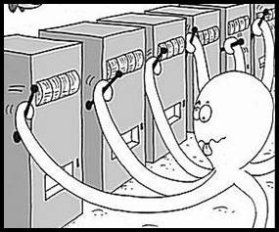
The k-armed bandit problem
Same as 1-armed bandit except that
there are now k levers instead of one

Slide 15
The k-armed bandit problem
Same as 1-armed bandit except that
there are now k levers instead of one
at each time step, t=1, 2, 3, …, you choose one action from a set of k possible actions (i.e., you choose a lever)
you receive a real valued reward after taking the action
reward depends only on action taken; it is identically, independently distributed (iid)
the expected reward for any action is unknown; distribution of rewards is unknown

Slide 16
The k-armed bandit problem
Same as 1-armed bandit except that
there are now k levers instead of one
at each time step, t=1, 2, 3, …, you choose one action from a set of k possible actions (i.e., you choose a lever)
you receive a real valued reward after taking the action
reward depends only on action taken; it is identically, independently distributed (iid)
the expected reward for any action is unknown; distribution of rewards is unknown
Goal: maximize total expected reward
How?

Slide 17
The k-armed bandit problem
Same as 1-armed bandit except that
there are now k levers instead of one
at each time step, t=1, 2, 3, …, you choose one action from a set of k possible actions (i.e., you choose a lever)
you receive a real valued reward after taking the action
reward depends only on action taken; it is identically, independently distributed (iid)
the expected reward for any action is unknown; distribution of rewards is unknown
Goal: maximize total expected reward
You must explore different actions and eventually maximize reward by selecting the action with the highest estimated expected reward

Slide 18
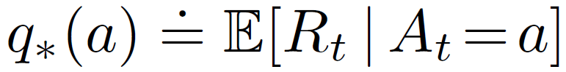
Q-values
Learning: Estimate the Q-values (expected rewards)
The expected value of
choosing action a

Slide 19
Q-values
Learning: Estimate the Q-values (expected rewards)
Call this the “Q-value”

Slide 20
Q-values
Learning: Estimate the Q-values (expected rewards)
Given some experience pulling an arm, how to estimate?

Slide 21
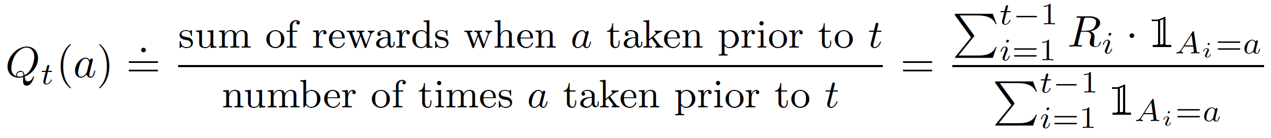
Q-values
Learning: Estimate the Q-values (expected rewards)
Given some experience pulling an arm, how to estimate?

Slide 22
Q-values
Learning: Estimate the Q-values (expected rewards)
Given some experience pulling an arm, how to estimate?
Notation: Textbook uses capital letters (Q) for estimates, lower-case letters (q) for true quantities

Slide 23
Q-values
Learning: Estimate the Q-values (expected rewards)
Given some experience pulling an arm, how to estimate?
Notation: Textbook uses capital letters (Q) for estimates, lower-case letters (q) for true quantities
Also note estimator Q_{t} depends on time t

Slide 24
Q-values
Learning: Estimate the Q-values (expected rewards)
Given some experience pulling an arm, how to estimate?
Notation: Textbook uses capital letters (Q) for estimates, lower-case letters (q) for true quantities
Also note estimator Q_{t} depends on time t
Q_{t}(a) is a sample average, converges to q*(a) in the limit Limit: Not just t → ∞ , need denominator N_{t}(a) → ∞

Slide 25
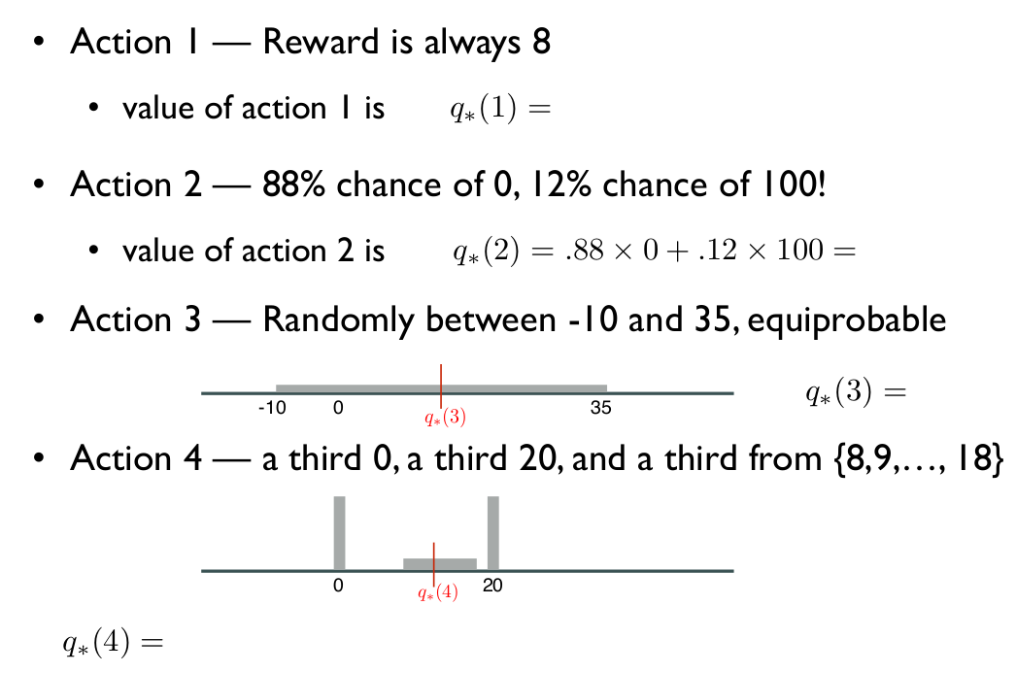
Question
Example of a 4-armed bandit:

Slide 26
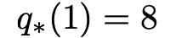
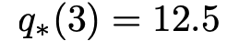
Question
Action 1 — Reward is always 8
value of action 1 is
Action 2 — 88% chance of 0, 12% chance of 100!
value of action 2 is
Action 3 — Randomly between -10 and 35, equiprobable
Action 4 — a third 0, a third 20, and a third from {8,9,…, 18}
-10
0
35
0
20

Slide 27
Question
How should you act?
Action 1 — Reward is always 8
value of action 1 is
Action 2 — 88% chance of 0, 12% chance of 100!
value of action 2 is
Action 3 — Randomly between -10 and 35, equiprobable
Action 4 — a third 0, a third 20, and a third from {8,9,…, 18}
-10
0
35
0
20

Slide 28
How to act?
In the previous example, reward distribution was given
What if it was unknown (the actual setting)?
Activity: Suppose you are faced with 4 arms, now with unknown payout. Suppose you can pull 100 times in total. How to act to maximize total expected reward?

Slide 29
Exploration vs Exploitation
Given an estimate of , how do we decide how to act?
Two possibilities:
1. Greedy action selection:
2. Do something else

Slide 30
Exploration vs Exploitation
Exploitation
Given an estimate of , how do we decide how to act?
Two possibilities:
1. Greedy action selection:
2. Do something else
Exploration

Slide 31
Exploration vs Exploitation
Exploitation
Given an estimate of , how do we decide how to act?
Two possibilities:
1. Greedy action selection:
2. Do something else
– if we don’t explore, then our q-value estimates may be wrong!
– if we don’t exploit, then we never utilize our knowledge!
Exploration

Slide 32
E-greedy action selection
In greedy action selection, you always exploit
In 𝜀-greedy, you are usually greedy, but with probability 𝜀 you instead pick an action at random (possibly the greedy action again)
This is perhaps the simplest way to balance exploration and exploitation

Slide 33
E-greedy example
ε-greedy
1. With probability 1-ε, take greedy action (exploit)
2. With probability ε, take an action uniformly at random (explore; might pick greedy action too)

Slide 34
E-greedy example
ε-greedy
1. With probability 1-ε = 0.5, take greedy action (exploit)
2. With probability ε = 0.5, take a random action → probability 0.25 for each of 2 possible actions
P(greedy action) = 0.5 + 0.25 = 0.75

Slide 35
Exploration vs Exploitation
Aside: Is this ‘optimal’?
How would you optimally explore and exploit?

Slide 36
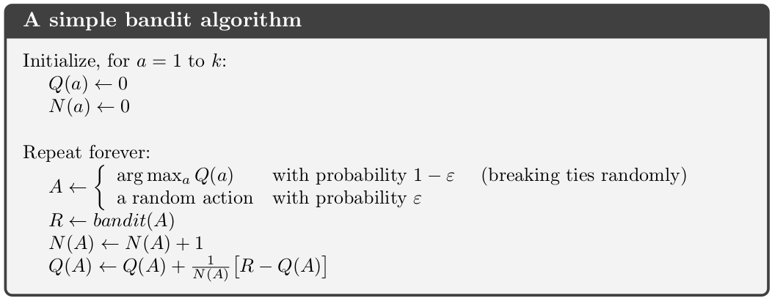
E-greedy k-armed bandit algorithm

Slide 37
E-greedy k-armed bandit algorithm
Incremental estimate of

Slide 38
E-greedy k-armed bandit algorithm
Incremental estimate of

Slide 39
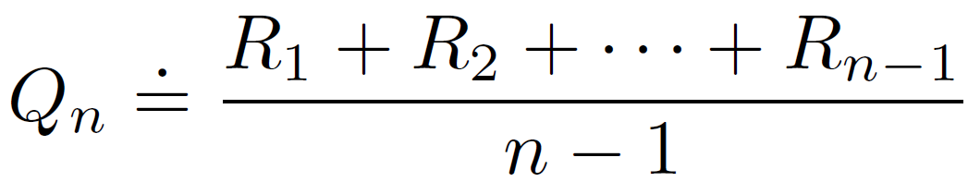
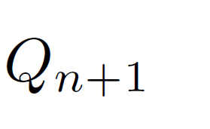
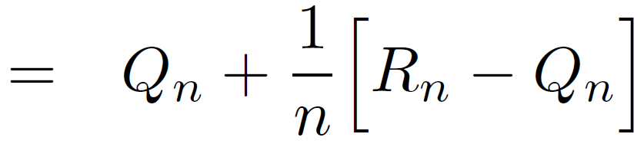
Incremental Q-value estimate
We want to estimate this:
To simplify notation, focus on one action:
This requires an unbounded amount of memory!
Actually, we can use our previous Q-value:

Slide 40
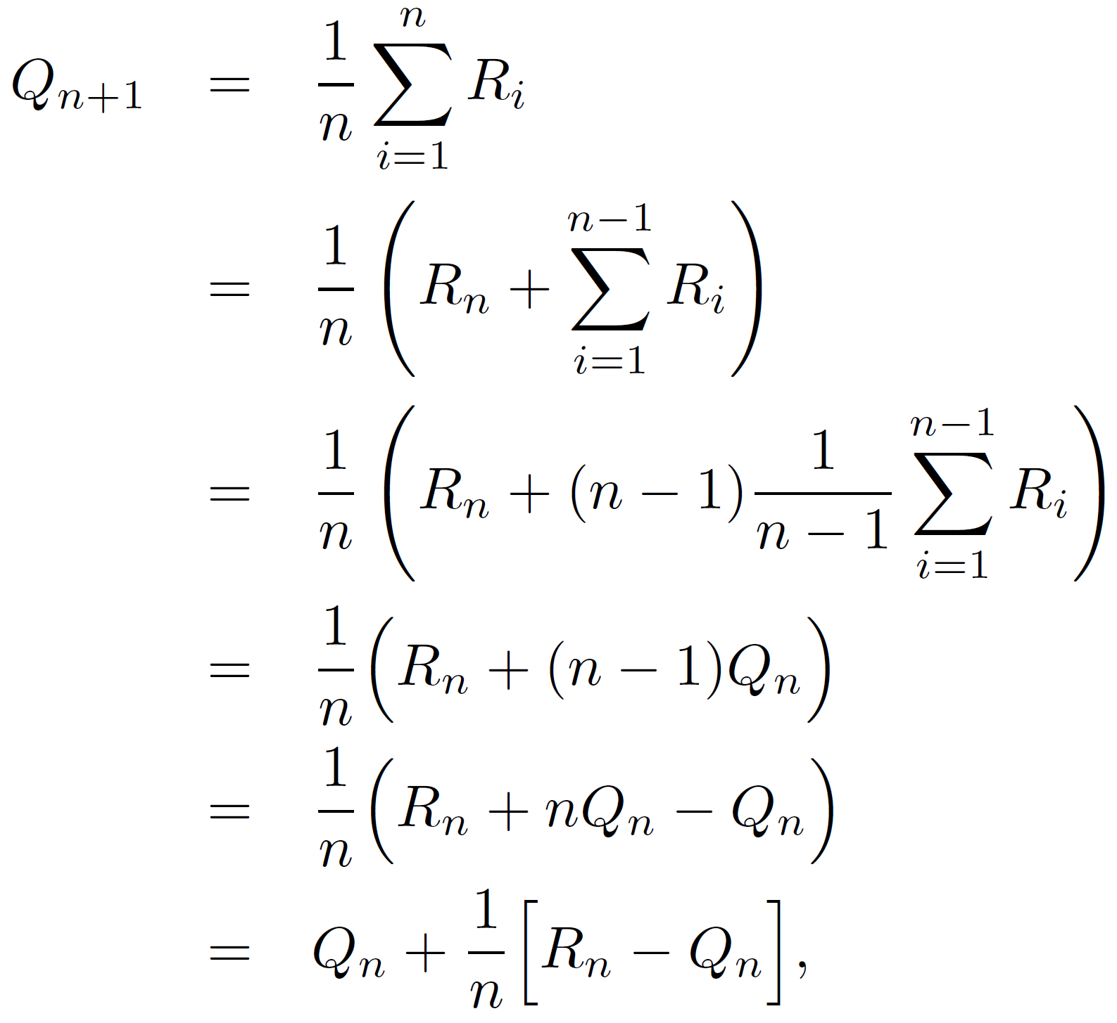
Incremental Q-value estimate
(p. 31 in textbook)

Slide 41
Incremental Q-value estimate
We want to estimate this:
Actually, we can use our previous Q-value:
We will see this form of update rule a lot:
α
error

Slide 42
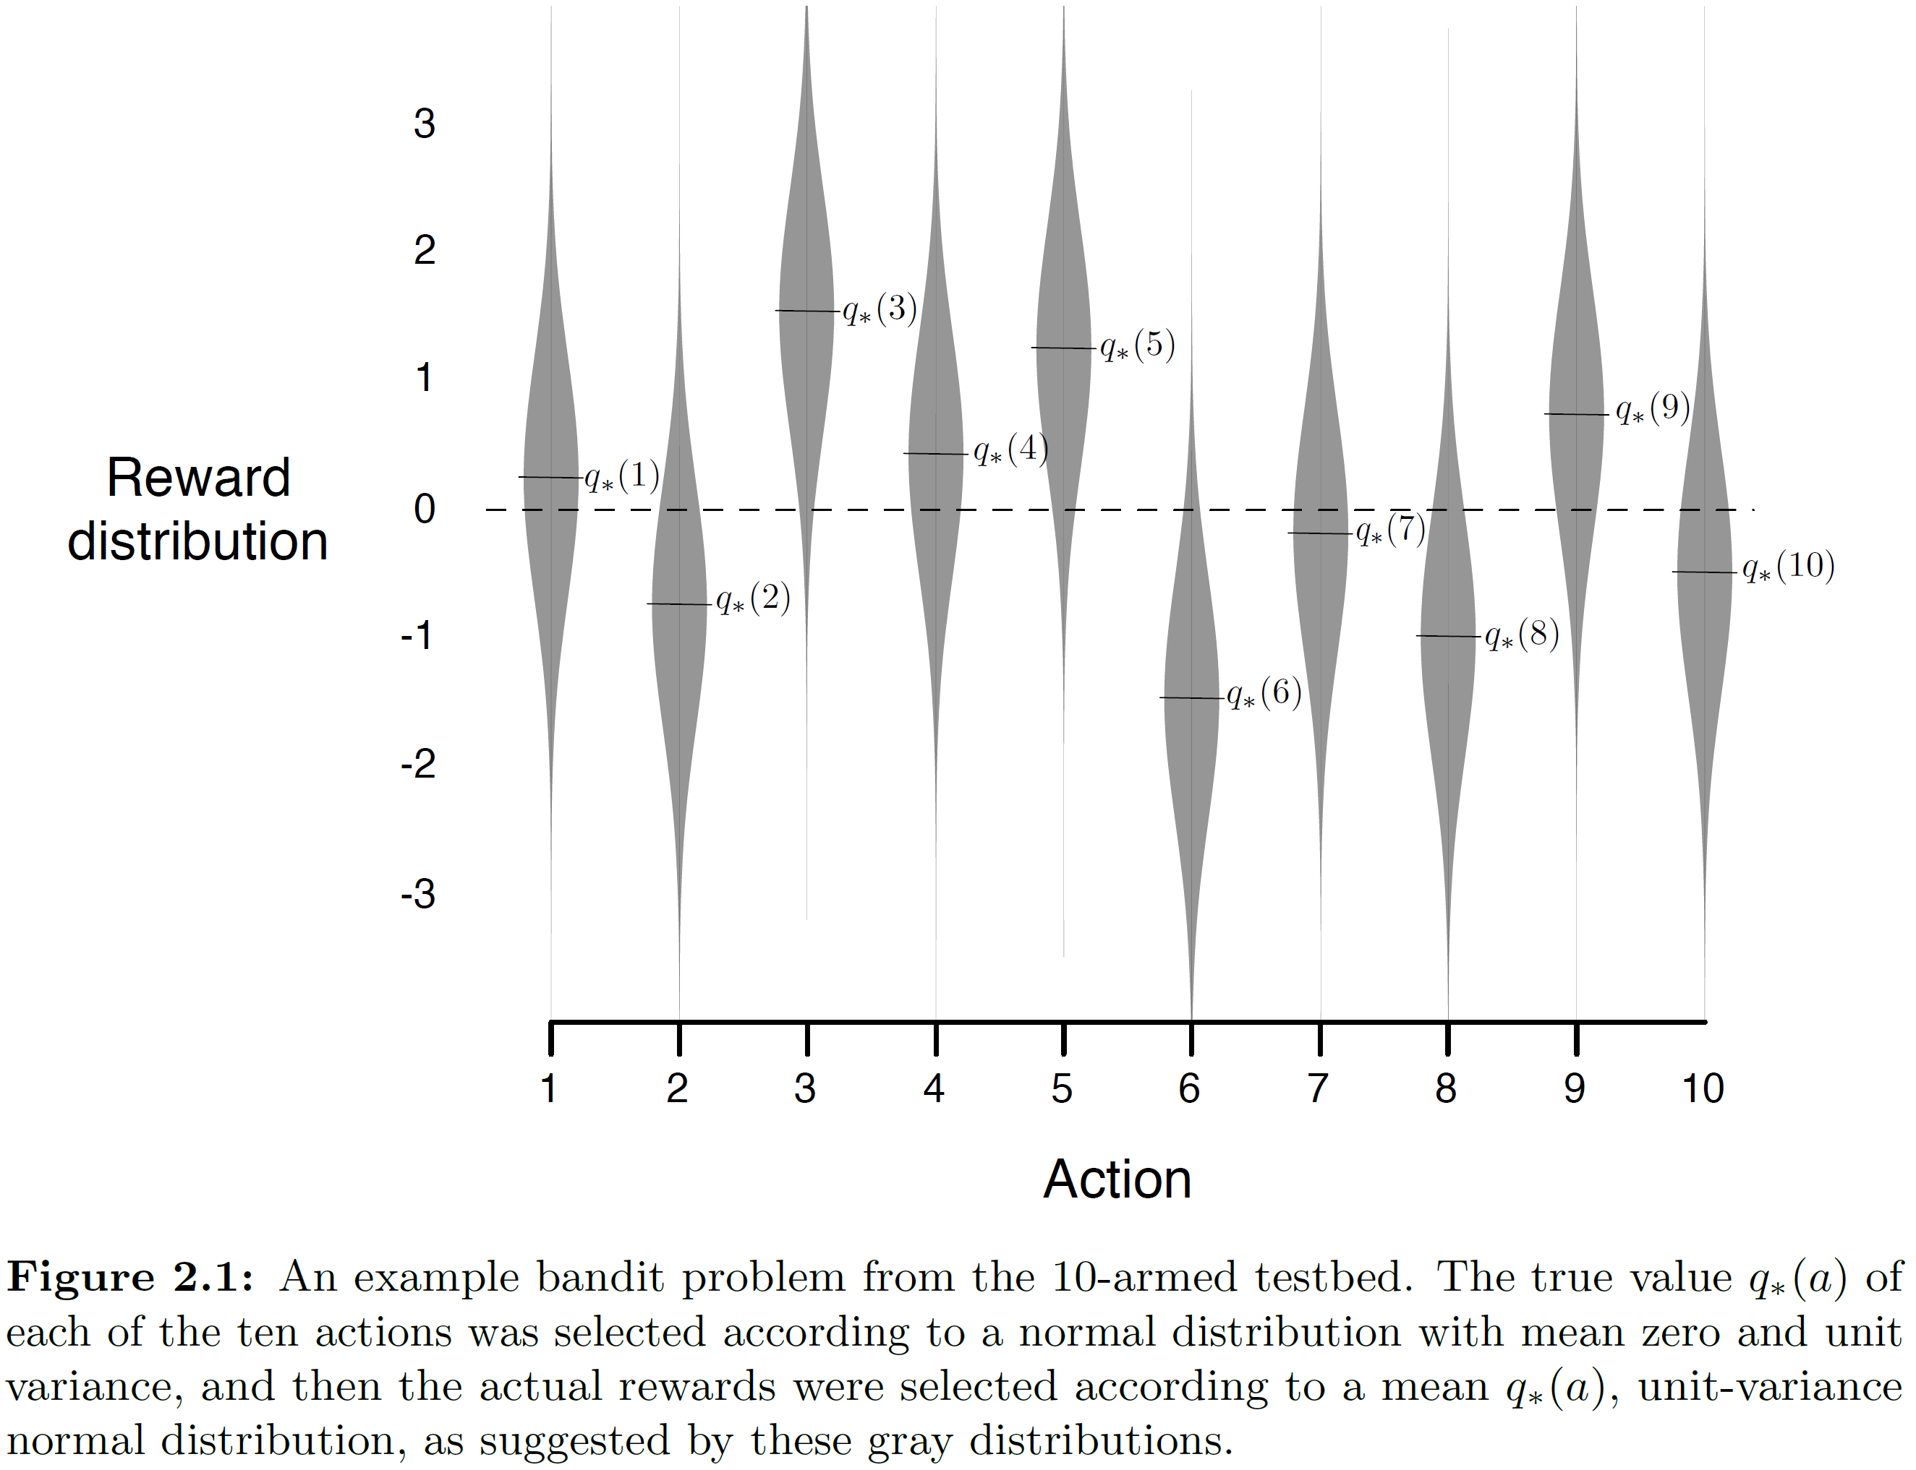
Example: 10-armed bandit

Slide 43
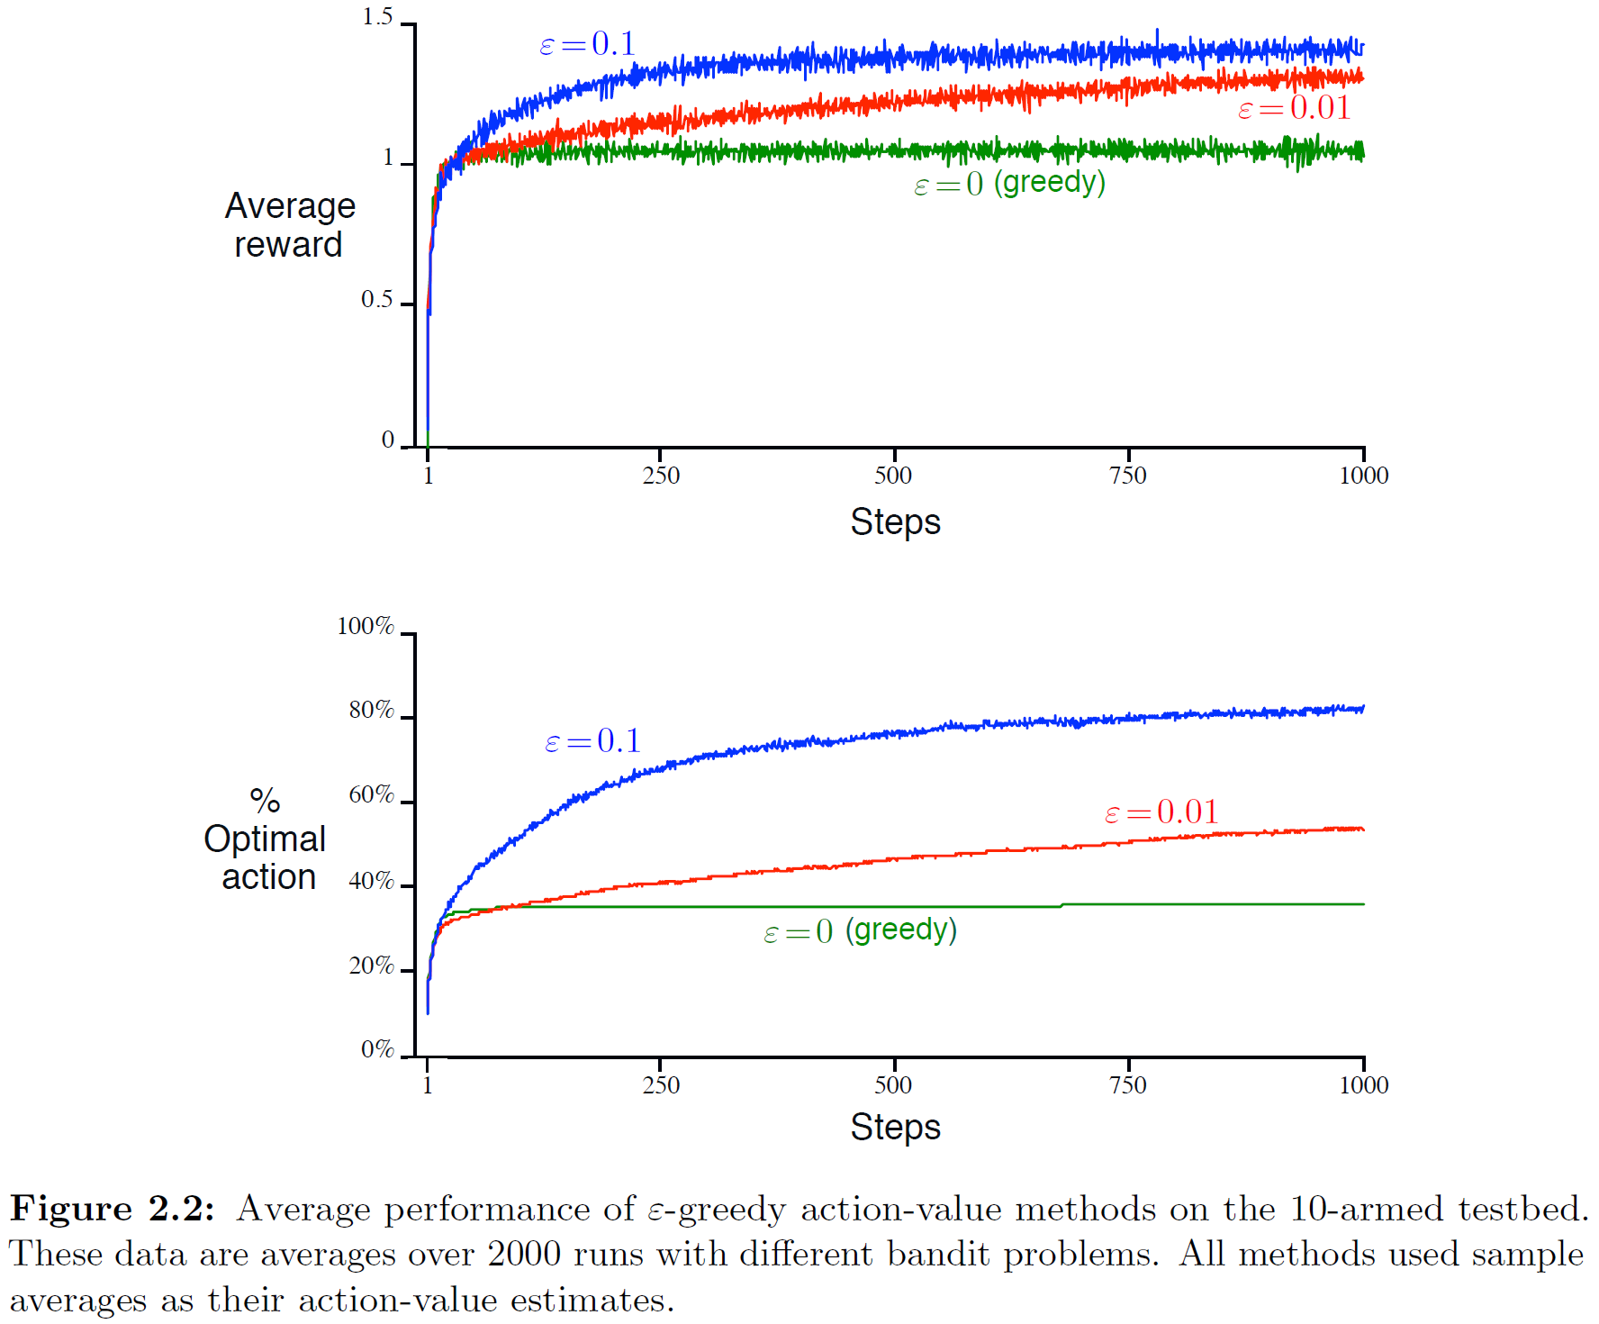
Example: 10-armed bandit

Slide 44
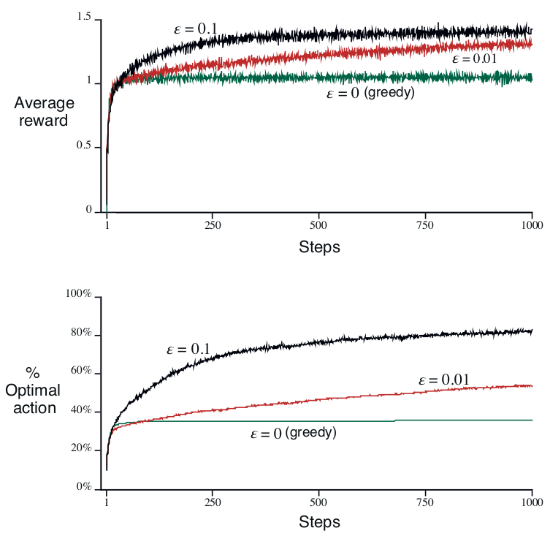
Think-pair-share question
Don’t need to be quantitative about intermediate performance only in the limit
Can use Q* and Q^{avg}
instead of the actual values
Figure 2.2

Slide 45
Solutions
For a fixed number of actions need to calculate area under the curve
Optimal average reward in the limit:
(1-𝜺)Q*+ 𝜺 Q^{avg}
For 𝜺=0.1
For 𝜺=0.01
Probability of selecting optimal action (in the limit):
1-𝜺+ 𝜺 x 1/numAct
For 𝜺=0.1 .9+.1x1/10=.9+.01=.91
For 𝜺=0.01 .99+.01x1/10=.99+.001=.991
Difference in prob of selecting optimal action
1-𝜺₁+ 𝜺₁ x 1/numAct – (1-𝜺₂+ 𝜺₂ x 1/numAct)
1-.01+.01x.1-(1-.1+.1x.1)=.99+.001-(.9+.01)=.081
Difference in average reward in the limit
.991Q*+.009Qavg-.91Q*-.09Qavg=Q*(.991-.91)+Qavg(.009-.09)
.081Q*-.081Qavg

Slide 46
Example: 10-armed bandit
Questions:
1. Why does greedy (ε = 0) behave poorly?
2. Is ε = 0.1 strictly better than ε = 0.01?
3. What ε should you choose?

Slide 47
Example: 10-armed bandit
What if the true action-values q* change over time?

Slide 48
Example: 10-armed bandit
What if the true action-values q* change over time?
Non-stationary problem

Slide 49
Incremental Q-value estimate
What might go wrong with sample averages?

Slide 50
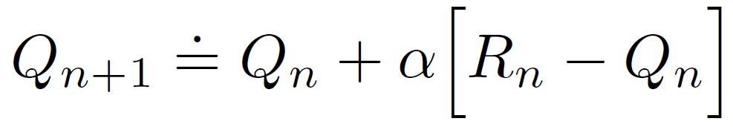
Incremental Q-value estimate
What might go wrong with sample averages?
A simple modification:

Slide 51
Incremental Q-value estimate
What might go wrong with sample averages?
A simple modification (exponential recency-weighted avg):
α is the step-size parameter, 0 < α ≤ 1

Slide 52
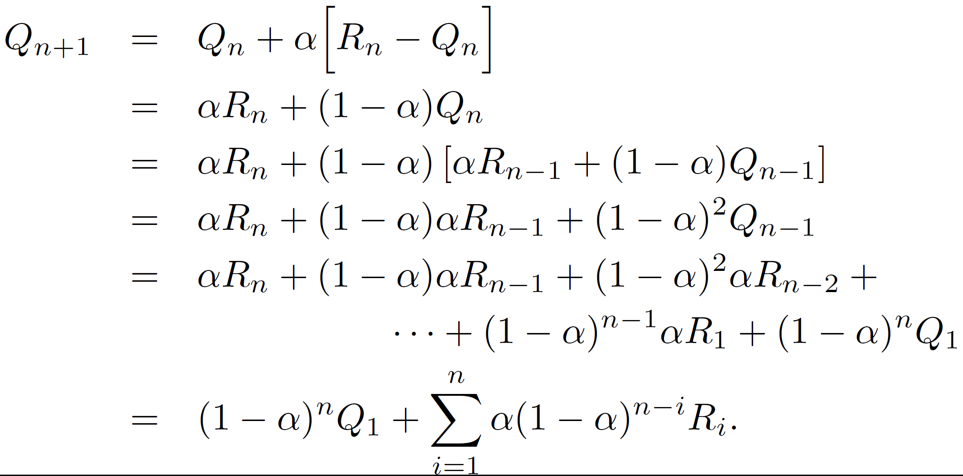
Exponential recency-weighted average
Where is the “exponential”?

Slide 53
Exponential recency-weighted average
Where is the “exponential”?
Note (diminishing) bias toward Q₁

Slide 54
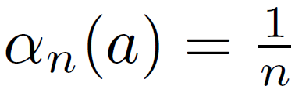
Exponential recency-weighted average
Step size may vary with step (e.g., sample average):

Slide 55
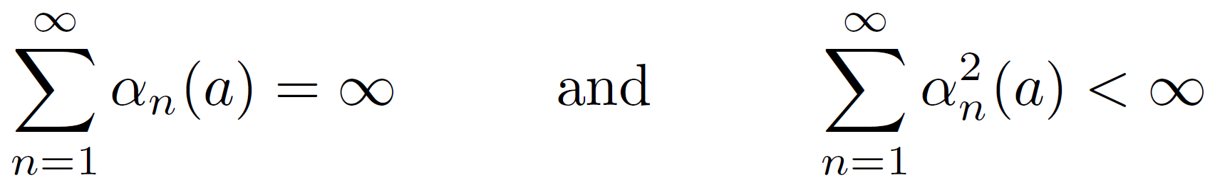
Exponential recency-weighted average
Step size may vary with step (e.g., sample average):
To ensure convergence with probability 1 (result from stochastic approximation theory):

Slide 56
Exponential recency-weighted average
Step size may vary with step (e.g., sample average):
To ensure convergence with probability 1 (result from stochastic approximation theory):
Large enough to Small enough to overcome initial bias guarantee convergence

Slide 57
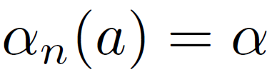
Exponential recency-weighted average
Step size may vary with step (e.g., sample average):
To ensure convergence with probability 1 (result from stochastic approximation theory):
Large enough to Small enough to overcome initial bias guarantee convergence
Does constant step-size satisfy this?

Slide 58
Exponential recency-weighted average
Step size may vary with step (e.g., sample average):
To ensure convergence with probability 1 (result from stochastic approximation theory):
Large enough to Small enough to overcome initial bias guarantee convergence
Does constant step-size satisfy this?
What happens when 𝛼=1?
What happens when 𝛼=0?

Slide 59
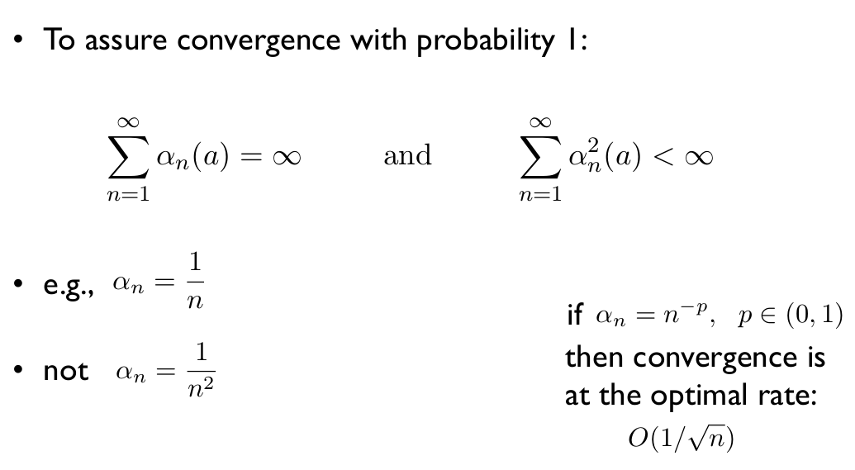
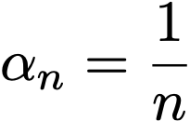
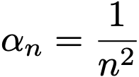
Convergence conditions
To assure convergence with probability 1:
e.g.,
not or
.
.
.
𝛼
These are standard conditions for convergence for any Monte Carlo estimate

Slide 60
Exponential recency-weighted average
In practice: “Although sequences of step-size parameters that meet these convergence conditions are often used in theoretical work, they are seldom used in applications and empirical research.”

Slide 61
Exponential recency-weighted average
In practice: “Although sequences of step-size parameters that meet these convergence conditions are often used in theoretical work, they are seldom used in applications and empirical research.”
- In practice, pick a small α and do some experiments
- If necessary, consider a schedule for decreasing α

Slide 62
Exponential recency-weighted average
In practice: “Although sequences of step-size parameters that meet these convergence conditions are often used in theoretical work, they are seldom used in applications and empirical research.”
- In practice, pick a small α and do some experiments
- If necessary, consider a schedule for decreasing α
- Similar comments for ε
- These are hyperparameters of our algorithm

Slide 63
Exponential recency-weighted average
In practice: “Although sequences of step-size parameters that meet these convergence conditions are often used in theoretical work, they are seldom used in applications and empirical research.”
- In practice, pick a small α and do some experiments
- If necessary, consider a schedule for decreasing α
- Similar comments for ε
- These are hyperparameters of our algorithm
- Tuning hyperparameters is an art (and an unfortunate reality of RL)

Slide 64
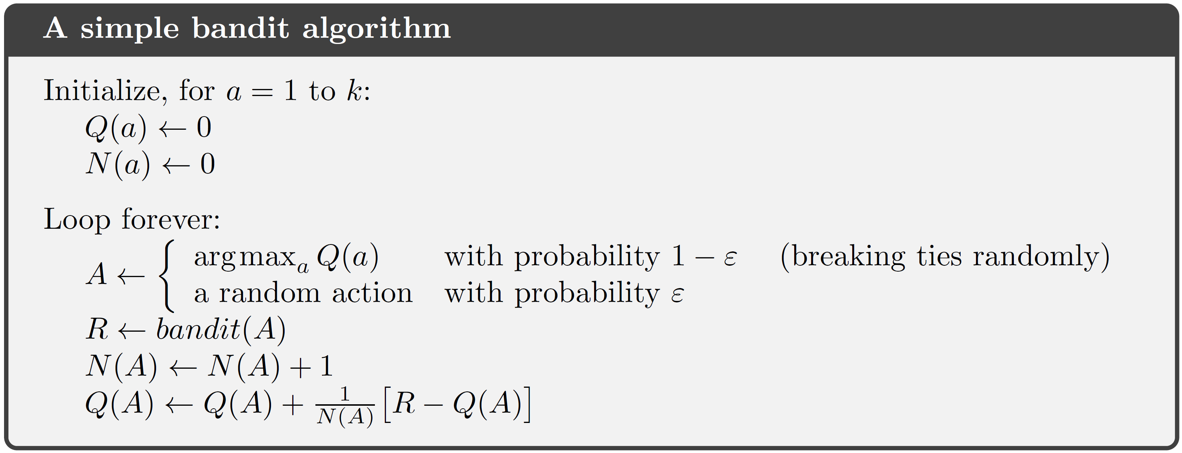
ε-greedy k-armed bandit algorithm
α
α and ε are hyperparameters

Slide 65
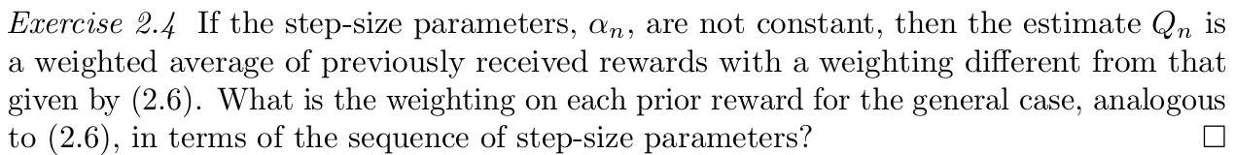
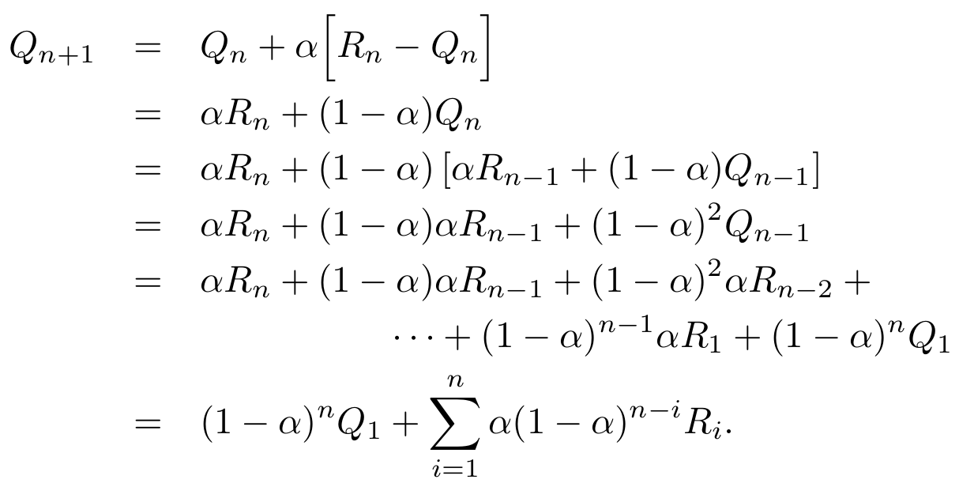
Think-pair-share
Weighting on prior rewards for constant-alpha case

Slide 66
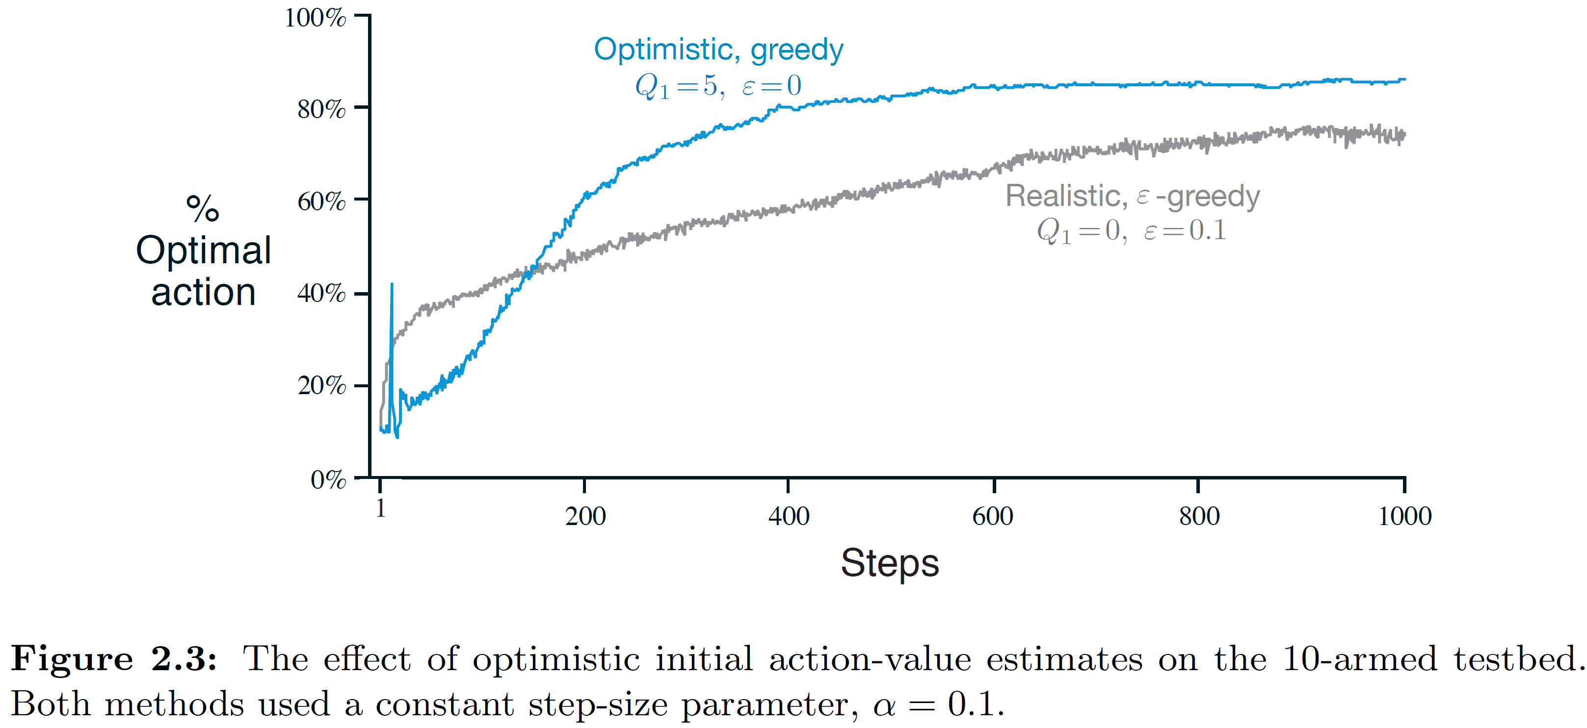
Optimistic initial values
What if we initialized Q(a) differently?
What if we initialized them optimistically?

Slide 67
Optimistic initial values
A simple trick
But doesn’t help with nonstationarity (need additional exploration)
Not always clear what is ‘optimistic’
Can work well in practice

Slide 68
Question
What do you think accounts for these spikes?
– these curves are averages over 2000
different 10-armed bandit tasks

Slide 69
ε-greedy k-armed bandit algorithm
Your choice
α
α and ε are hyperparameters
Initial Q-values also can be viewed as hyperparameters

Slide 70
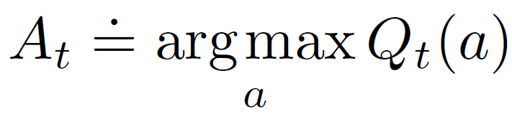
How to act?
Given estimates Q_{t}(a) for all actions, what action to take?
Two natural possibilities:
1. Greedy action selection:
Exploitation
2. Do something else Exploration
How to decide between these two?
One simple possibility: ε-greedy
Are there other reasonable decision rules?

Slide 71
How to act?
Given estimates Q_{t}(a) for all actions, what action to take?
Two natural possibilities:
1. Greedy action selection:
Exploitation
2. Do something else Exploration
How to decide between these two?
One simple possibility: ε-greedy
Are there other reasonable decision rules?
What if some actions are clearly not worth trying?

Slide 72
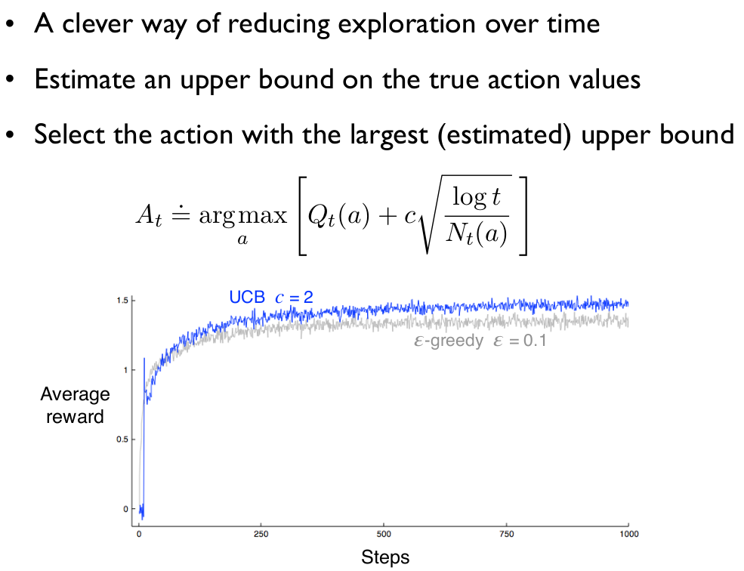
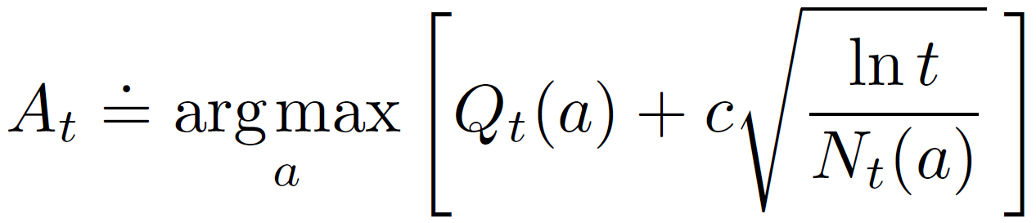
UCB action selection
Number of times a has
been taken up to timestep t

Slide 73
UCB action selection
This term is an estimate of our uncertainty
(as N_{t}(a) grows relative to lnt, this shrinks)

Slide 74
UCB action selection
c controls the amount of exploration

Slide 75
UCB action selection
This term is an upper bound on the likely value
of this action based on our uncertainty
That is, choose the action that could possibly
be the best

Slide 76
UCB action selection
This term is an upper bound on the likely value
of this action based on our uncertainty
The cool thing about the UCB form is that regret is bounded
logarithmically w/ the number of timesteps (theoretically optimal)

Slide 77
UCB action selection
Regret: difference between your expected return
using this strategy and how well you might have
done if you knew which arm was best in advance
This term is an upper bound on the likely value
of this action based on our uncertainty
The cool thing about the UCB form is that regret is bounded
logarithmically w/ the number of timesteps (theoretically optimal)

Slide 78
UCB action selection
- Second term: Upper bound on the likely value of action a, a measure of uncertainty / variance in the estimate
- c is a hyperparameter, controls amount of exploration
- N_{t}(a) = number of times a has been taken up to time t
What happens if you have never tried arm a?

Slide 79
UCB action selection
- Second term: Upper bound on the likely value of action a, a measure of uncertainty / variance in the estimate
- c is a hyperparameter, controls amount of exploration
- N_{t}(a) = number of times a has been taken up to time t
What happens as you try arm a more times?

Slide 80
UCB action selection
- Second term: Upper bound on the likely value of action a, a measure of uncertainty / variance in the estimate
- c is a hyperparameter, controls amount of exploration
- N_{t}(a) = number of times a has been taken up to time t
What happens if c is increased?

Slide 81
UCB action selection
- Second term: Upper bound on the likely value of action a, a measure of uncertainty / variance in the estimate
- c is a hyperparameter, controls amount of exploration
- N_{t}(a) = number of times a has been taken up to time t
What happens if we stop trying arm a?

Slide 82
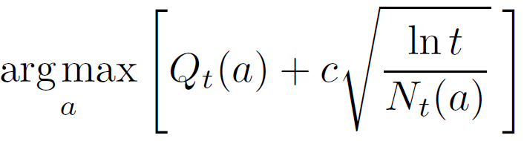
k-armed bandit algorithm with UCB
Your choice
Use Q(a) instead of Q_{t}(a) and N(a) instead of N_{t}(a)
α
α and c are hyperparameters
Initial Q-values also can be viewed as hyperparameters

Slide 83
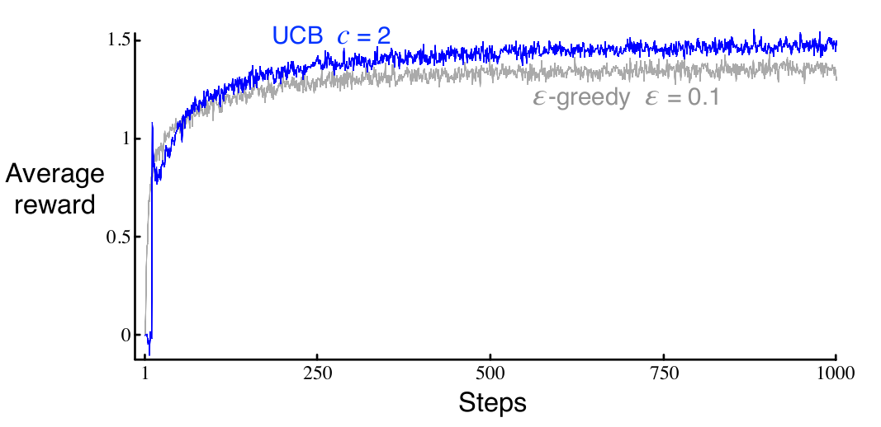
UCB action selection
Can outperform simpler exploration methods such as 𝜀-greedy

Slide 84
Think-pair-share
What do you think accounts for this spike?
– it happens on the 11th step
– again, these curves are averaged
– would it be different for different c?

Slide 85
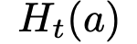
Gradient-Bandit Algorithms
Let be a learned preference for taking action a
Notes:
What if the problem is non-stationary?

Slide 86
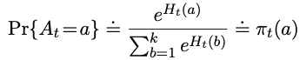
Gradient-Bandit Algorithms
Let be a learned preference for taking action a
Gives a stochastic policy with
𝜋_{t}(a) the probability of choosing
action a at timestep t
Notes:
What if the problem is non-stationary?

Slide 87
Gradient-Bandit Algorithms
Let be a learned preference for taking action a
What is the effect of different H?
Notes:
What if the problem is non-stationary?

Slide 88
Gradient-Bandit Algorithms
Let be a learned preference for taking action a
When all preferences are the same,
this is uniform and becomes more
peaky as the preferences differ
Notes:
What if the problem is non-stationary?

Slide 89
Gradient-Bandit Algorithms
Let be a learned preference for taking action a
soft-max distribution
Notes:
What if the problem is non-stationary?

Slide 90
Gradient-Bandit Algorithms
Let be a learned preference for taking action a
Learning the preferences by stochastic gradient ascent:
The action actually selected
Notes:
What if the problem is non-stationary?

Slide 91
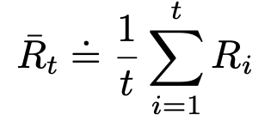
Gradient-Bandit Algorithms
Let be a learned preference for taking action a
Learning the preferences by stochastic gradient ascent:
where
Call this a baseline
Notes:
What if the problem is non-stationary?

Slide 92
Gradient-Bandit Algorithms
Let be a learned preference for taking action a
Learning the preferences by stochastic gradient ascent:
where
Which can also be computed
incrementally as before
Notes:
What if the problem is non-stationary?

Slide 93
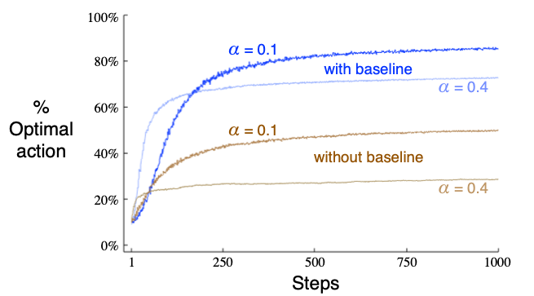
Gradient-Bandit Algorithms
Results on a variant of the 10-arm bandit problem with mean reward=4
Notes:
What if the problem is non-stationary?

Slide 94
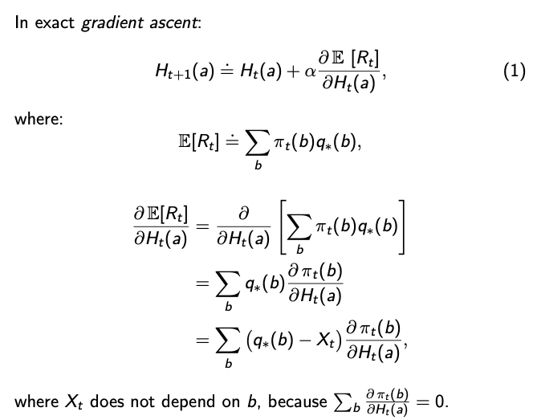
Derivation of gradient-bandit algorithm
We don’t know q*(b), but let’s look at the partial derivative

Slide 95
Derivation of gradient-bandit algorithm
Plugging in 𝔼[R_{t}]

Slide 96
Derivation of gradient-bandit algorithm
q*(b) doesn’t
depend on H_{t}(a)

Slide 97
Derivation of gradient-bandit algorithm

Slide 98
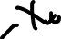
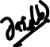
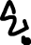
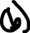
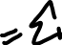
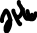
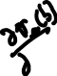
Derivation of gradient-bandit algorithm

Slide 99
Derivation of gradient-bandit algorithm
Probabilities sum to 1

Slide 100
Derivation of gradient-bandit algorithm
The baseline

Slide 101
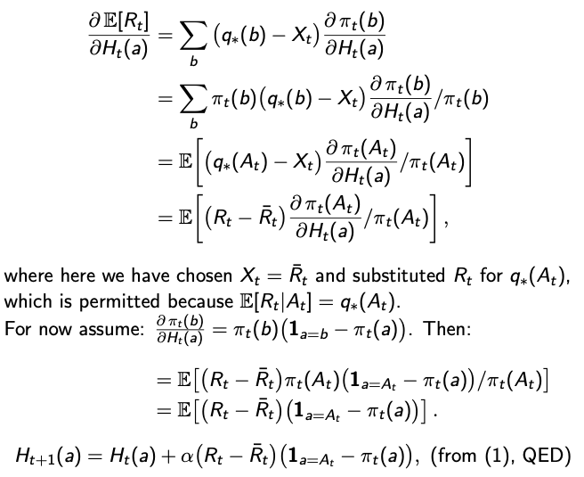

Slide 102
Multiplying by 𝜋_{t}(b)/𝜋_{t}(b)

Slide 103
𝜋_{t}(b) is the probability and
the term in the brackets
is the value

Slide 104
Using this particular
baseline
𝔼[R_{t}|A_{t}]=q*(A_{t})

Slide 105
Replace with
partial derivative

Slide 106
Cancel 𝜋_{t}(A_{t})

Slide 107
Stochastic
gradient ascent

Slide 108
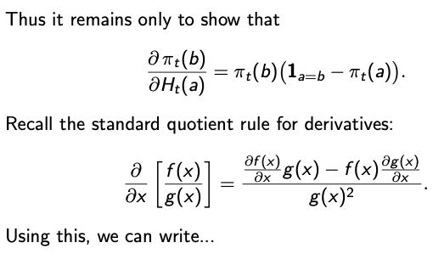

Slide 109
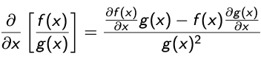
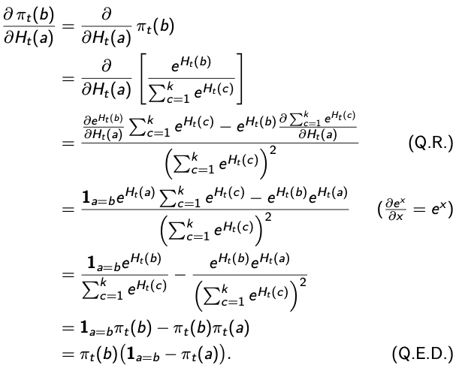
Quotient Rule:

Slide 110
Think-pair-share
Results on a variant of the 10-arm bandit problem with mean reward=4
Why are the baseline results so much better?
Why are the methods doing worse with larger 𝛼?
What would happen if the mean reward was 0?
Notes:
What if the problem is non-stationary?

Slide 111
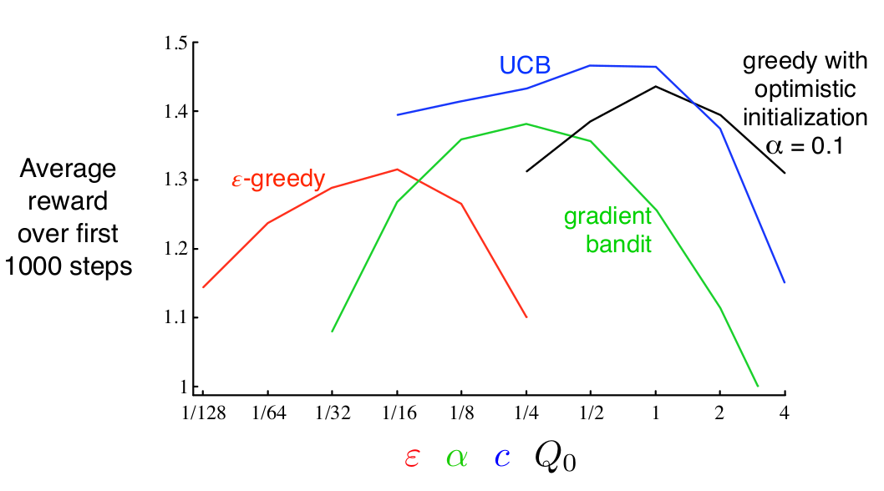
Comparison of Bandit Algorithms

Slide 112
Contextual bandits
Imagine you are solving a k-armed bandit problem, but the problem changes (randomly) each time step
(you get one of n bandit problems)
You can recognize what bandit
problem you are in
This is the associative or
contextual case

Slide 113
Contextual bandits
Imagine you are solving a k-armed bandit problem, but the problem changes (randomly) each time step
(you get one of n bandit problems)
You can recognize what bandit
problem you are in
This is the associative or
contextual case

Slide 114
Contextual bandits
Imagine you are solving a k-armed bandit problem, but the problem changes (randomly) each time step
(you get one of n bandit problems)
You can recognize what bandit
problem you are in
This is the associative or
contextual case
Note that this is still not the full RL problem
(the action choice doesn’t affect the state)

Slide 115
Summary
Action values
Commonly used throughout RL (e.g., Q-learning)
UCB
Similar ideas used for exploration bonuses in RL and planning (e.g., Monte Carlo tree search)
Gradient methods
Commonly used throughout RL (e.g., policy gradient methods)

